Slide 1
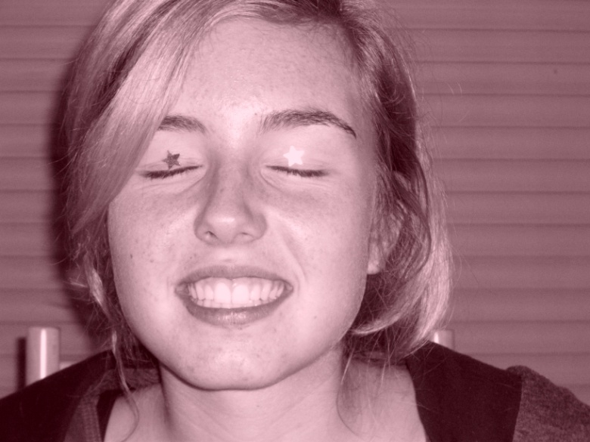
Welcome ☺ I’m Valentine Tollini
I’m 15 years old, and I go to school at Colombes , a city located next to Paris.

Slide 2
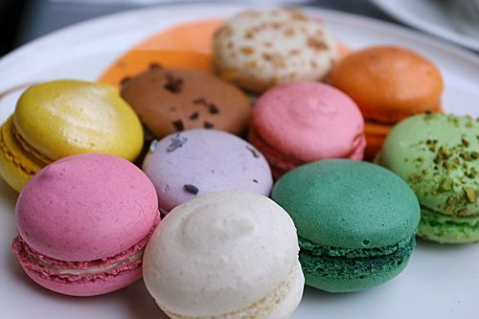
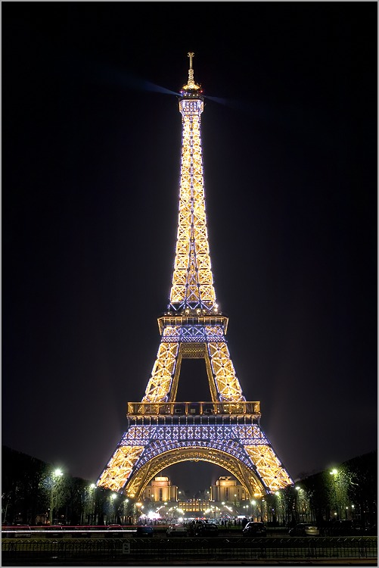
Things I like :
French food : macarons, foie gras…
Movies : 30 days of night, jeux d’enfants (sorry for the french title, but I don’t think the movie has been translated ;) )
Places : Paris by night (of course)

Slide 3
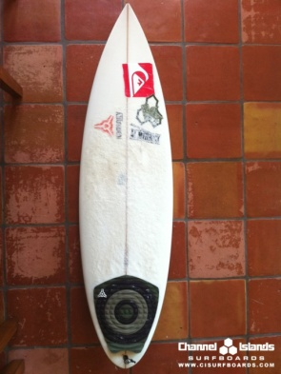
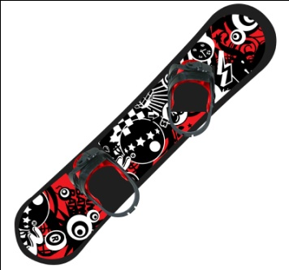
Hobbies :
I surf in summer
I do some skiing and snowboarding in winter
And I practice rock climbing during school time ☺

Slide 4
Thanks for watching my « self presentation »
Enjoy your winter holidays ☺
Bye !

