Slide 1
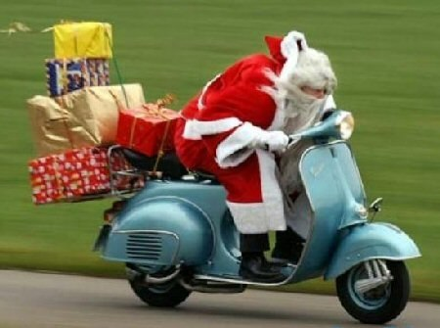
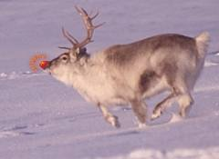
Well hello there !
I’ll bet you weren’t expecting that !
So. My class and I were wondering…Poland is like Wonderland to us, what with the distance and all. So we did think of one essential question we’d like to ask you. Near vital in fact. Do you believe in Santa Claus, and his friend Rudolf the red-nosed reindeer ?

