Slide 1
5 questions for the polish students.

Slide 2
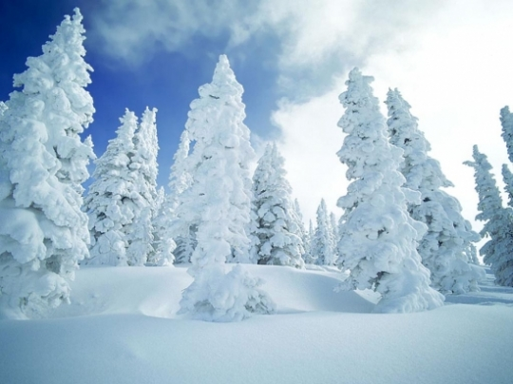
Is it very cold all year long ?

Slide 3
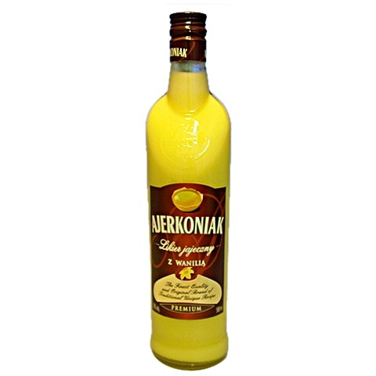
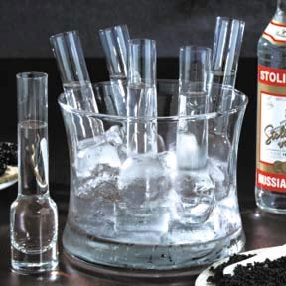
HoW's YoUr Beer ? :P

Slide 5
