Slide 1
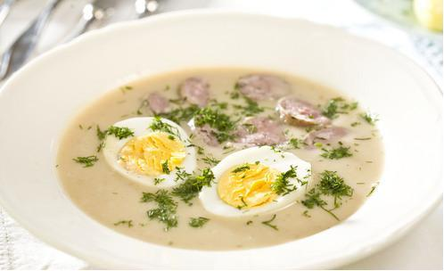
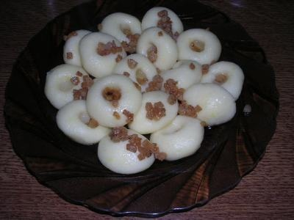
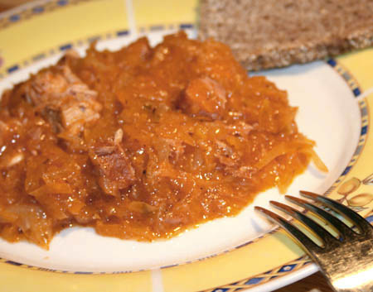
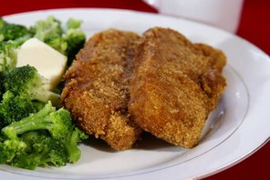
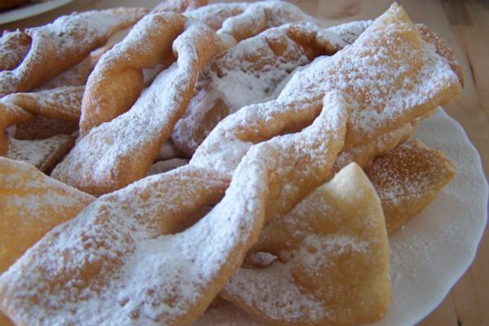
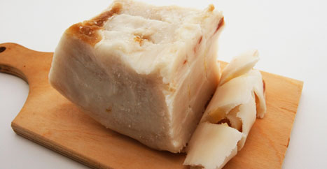
Eating with Poland
Faworki - are a traditional sweet crispy pastry made out of dough that has been shaped into thin twisted ribbons
Smalec - partially double fried lard with onion, marjoram. It is spread over bread and served together with pickled cucumbers as an appetizer before the main meal.
Dobrou Chuť
Bon Appétit
Bigos - appetizing, seasoned stew made from sauerkraut with chunks of various meats and sausages.
Żurek - Sour rye soup with potato, sausage or an egg, sometimes served in a bread loaf.
Kotlet Schabowy - traditional breaded pork cutlet (a tasty choice if you do not want any risk)
Kluski śląskie -Silesian dumplings, made from boiled potatoes.

