Slide 1
Hi,I´m Petr Hanzálek I´m 17 years old.

Slide 2
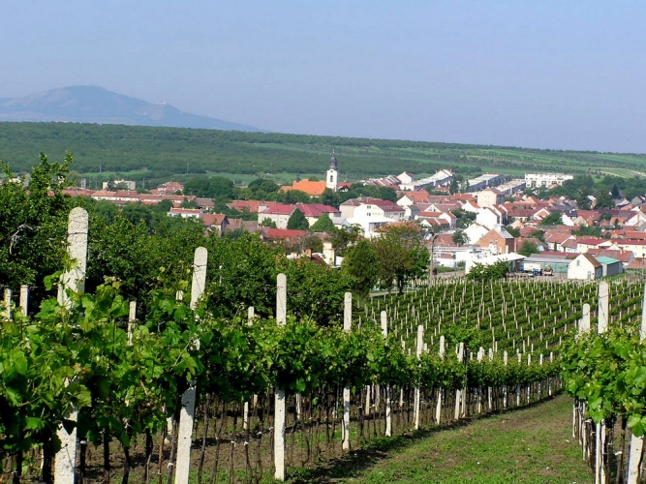
I live in Velké Pavlovice

Slide 3
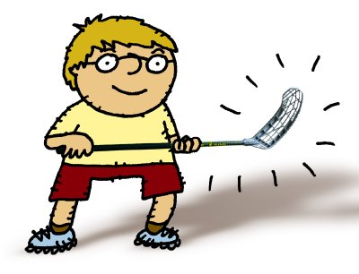
My hobbies are:sports,computers and playing the violin

