Slide 1
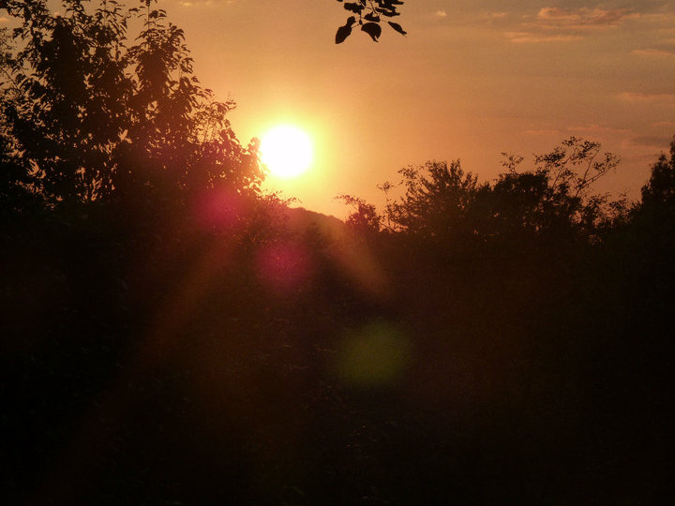
Hi ! My name is Nastasia Raë, I’m 16 years old, and I live in Colombes, a city near Paris. I would like to show you things I love !

Slide 2
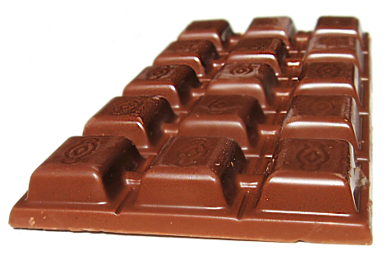
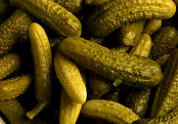
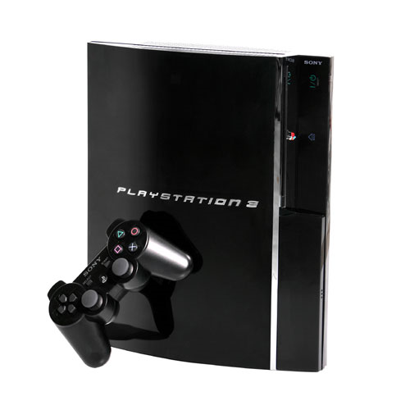
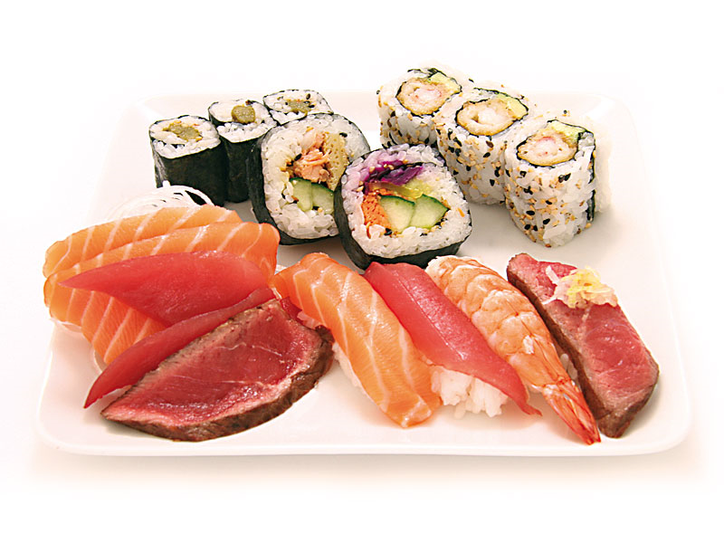
Things I like :
Video games

Slide 3
Others things I like :
I love dancing, singing, shopping, eating ..
I love movies !
I like reading books, especially crime fiction.
I love spending time with my friends and my family !
I like going to the cinema.
I like photography and graphics.

Slide 4
Thanks for watching my personal presentation !
Bye bye !
Nastasia.

