Slide 1
Hi, I am Martin Jilka and I come from small city in Moravia in Czech republic.

Slide 2
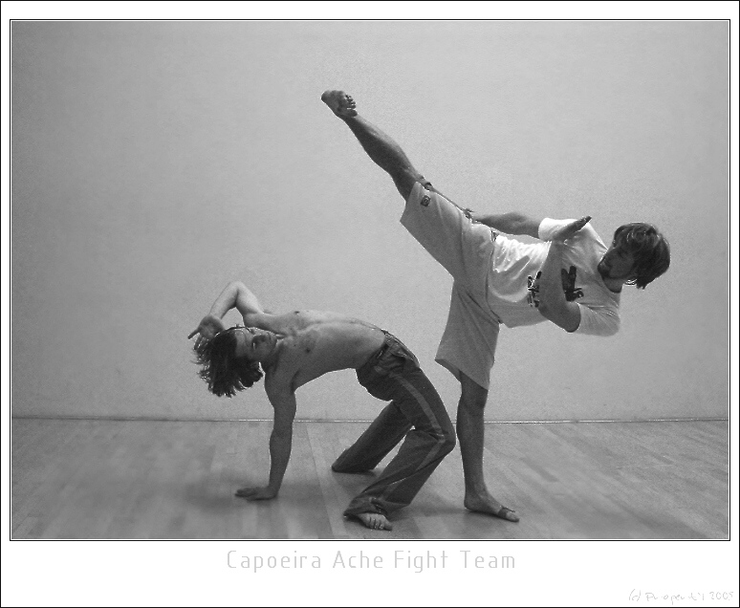
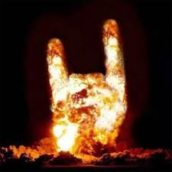
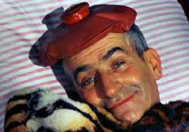
Now, I will tell to you, what I like.
Capoeira
METAL
FUN

Slide 3
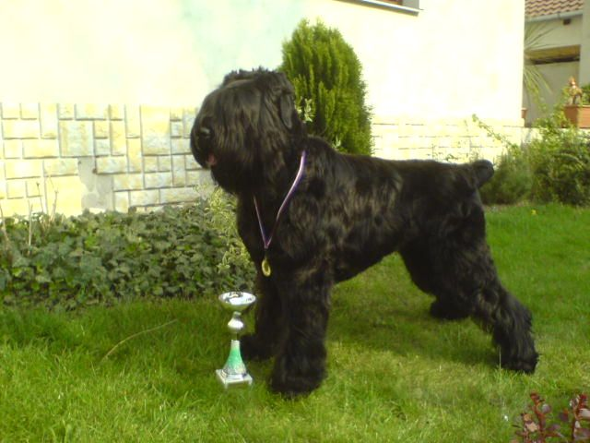
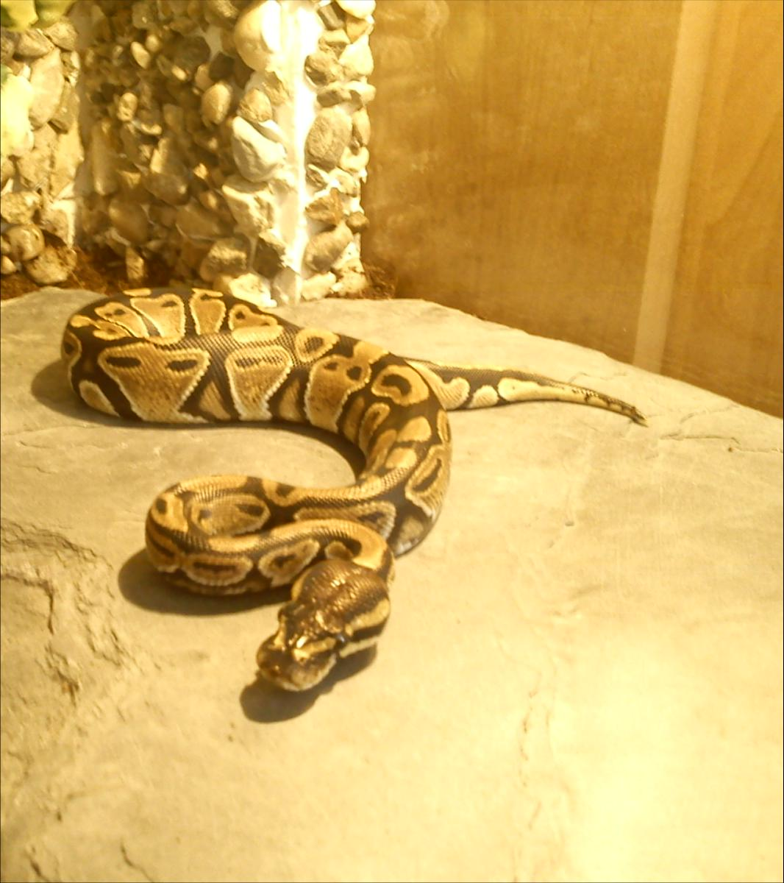
My pets!
DOG
SNAKE

