Slide 1
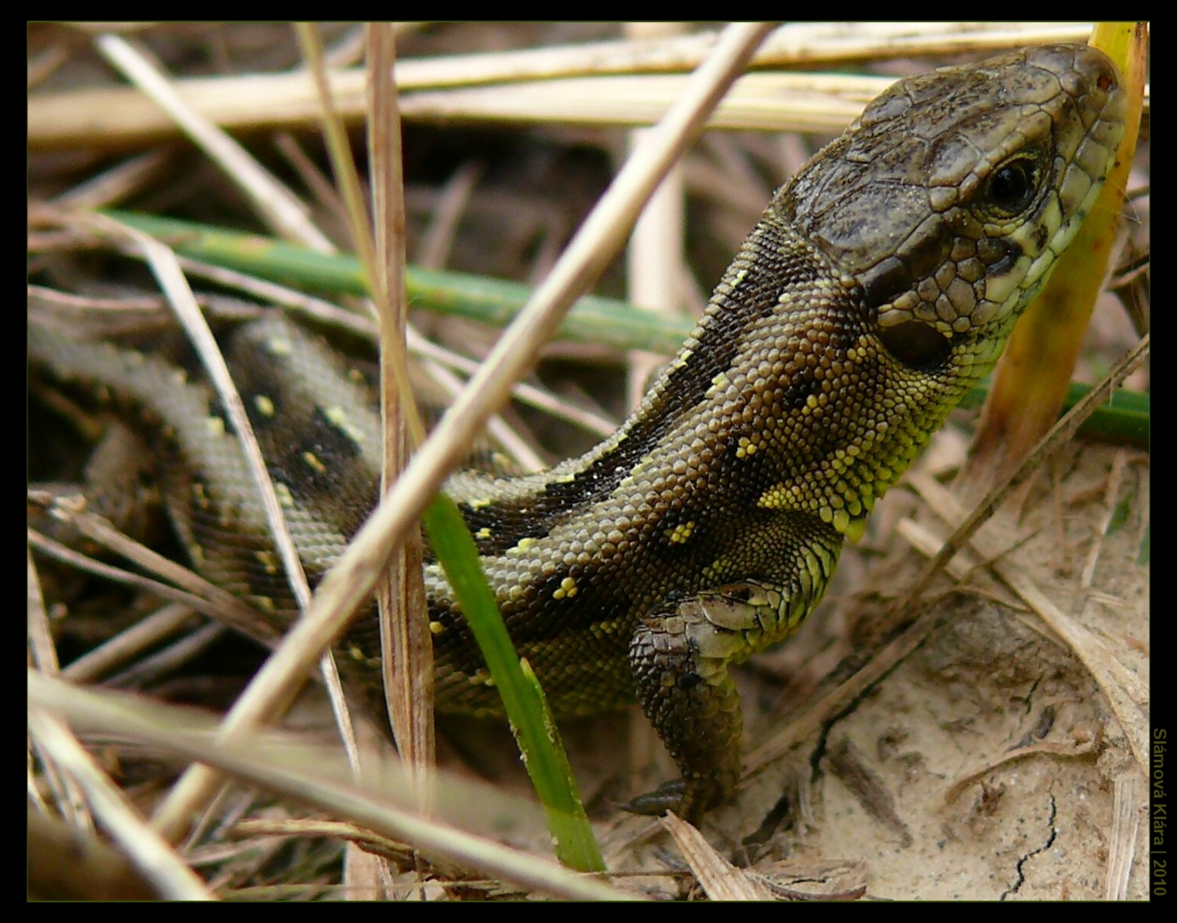
About me…
Hi. I would like to tell you about me. My name‘s Klára Slámová. I‘m 17 years old and I live in small village in Moravia in Czech republic. My best hobby‘s photography.
One of photo by me ☺

Slide 2
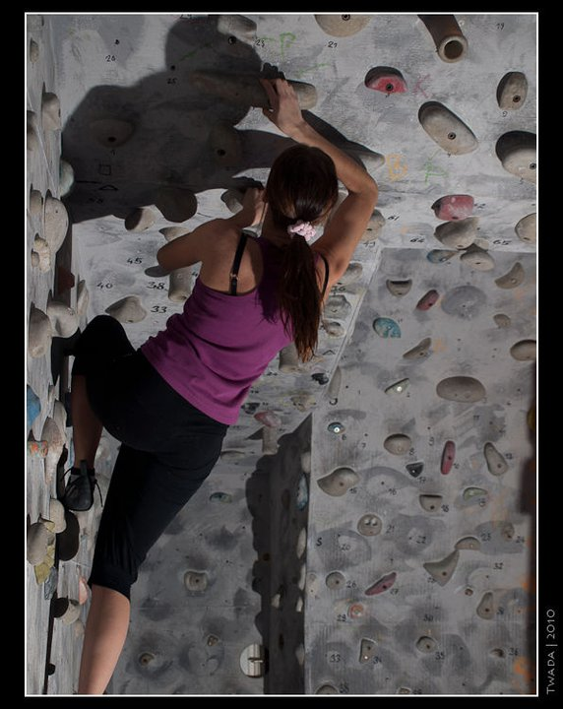
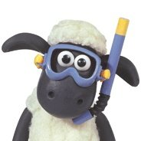
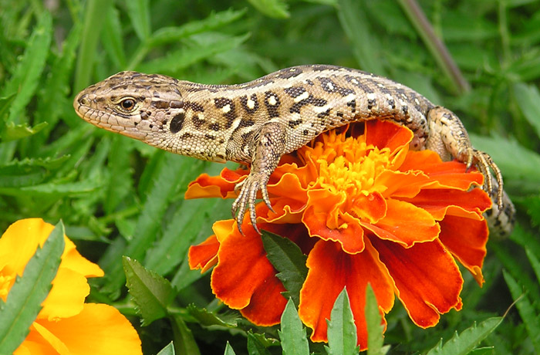
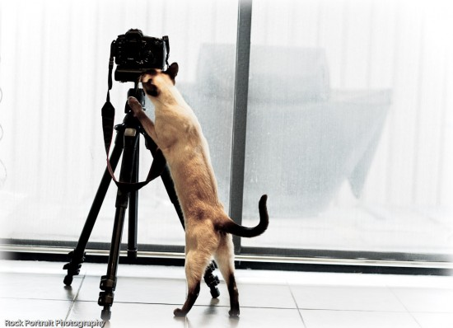
I LIKE Y
BOULDER WALL
This Is me ☺
SHAUN THE SHEEP
LIZARDS
PHOTOGRAPHING

