Slide 1
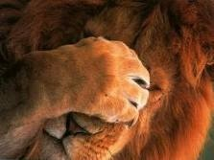
Hello My Dears!
I want to tell you something about me ☺
SO LET‘S HAVE A LOOK

Slide 2
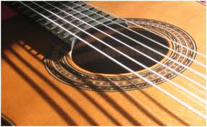
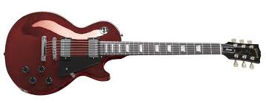
NAME: BIRTHDATE: AGE: HOBBIES:
Karolína Osičková; female
4th June 1994
16
…and little crazy about books…

Slide 3
I hope you will like me ! ☺

