Slide 1
Hello I’m Jurek Something about me…

Slide 2
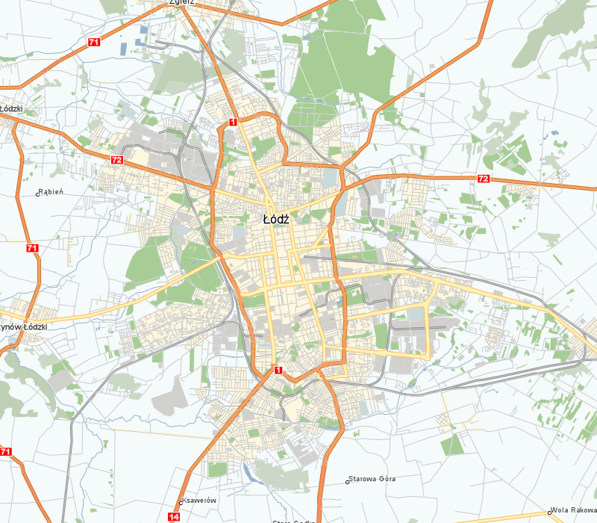
I live…
I live in the center of Poland in Łódź with my Mum, Grandmum and Sister. I’ve got a Dog her name is Łatka and now she has 5 puppies all have 4 weeks. I have got a house on a suburbs of the city so there it’s quiet and safe. By tram I can be in center in about 25 minutes.

Slide 3
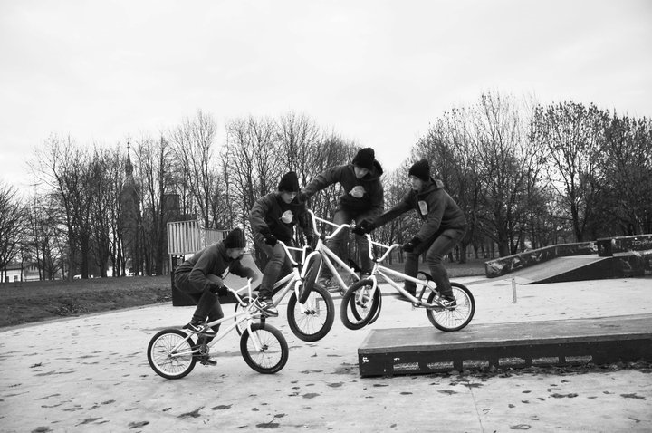
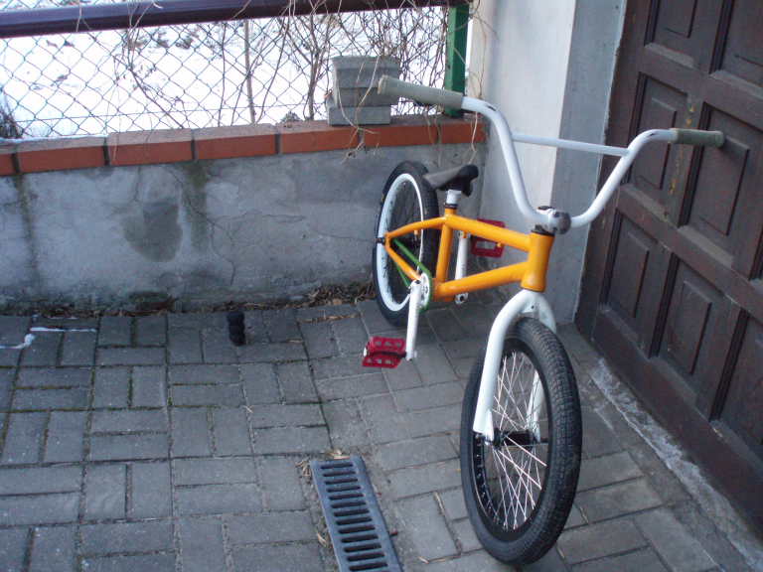
My hobby …
…is BMX bike. I like to ride a bike and I’m doing it always if I have got time. I think it’s great feeling if you learn new tricks. Sometimes to learn something stupid you have try it very long time but it’s great feeling when you can do it.

Slide 4
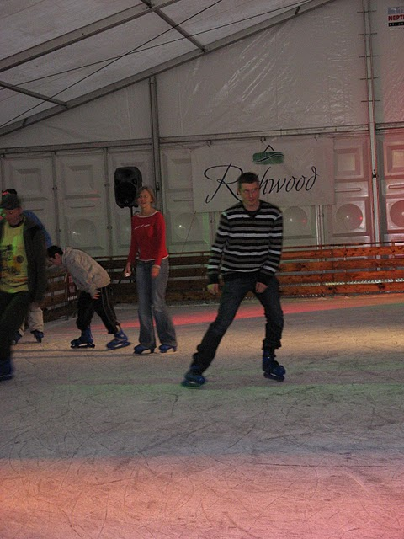
Free time in winter…
…I’m keen on iceskating. I like going with my friends to skating rink, all of my friends can iceskate well so we have lot of fun together. Sometimes we do stupid funny things but service aren’t happy about that.

Slide 5
My favourite movie …
is Fast and Furious and I think all parts of this film are great . I like cars. I think that good tuned cars are excellent. Also races and fast actions are making this movie super one.
Part I
Part II
Part III
Part IV

Slide 6
…Thats all

