Slide 1
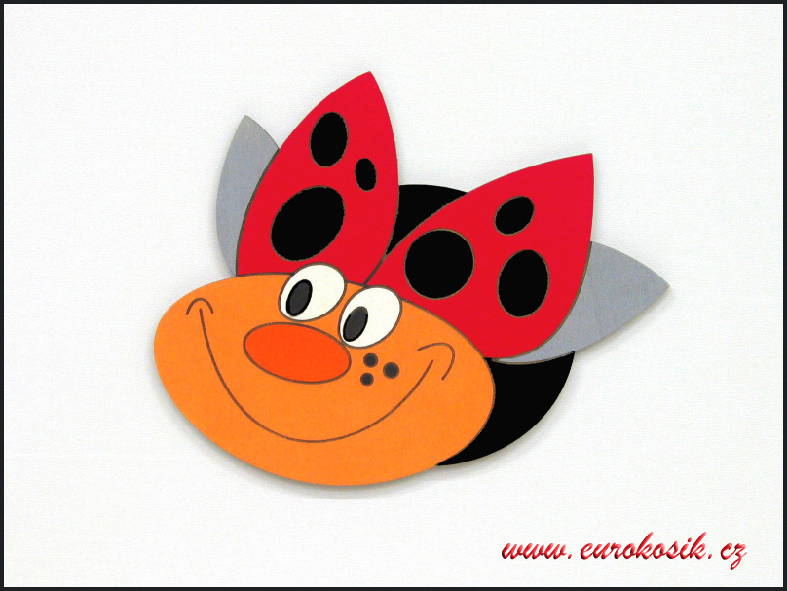
Me and
my little soul

Slide 2
I´m Anna and I´m 16 years old. And I would like to write something about me. Can I? ☺

Slide 3
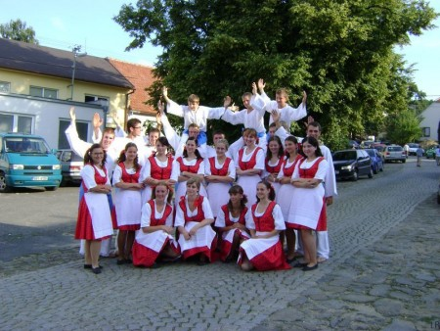
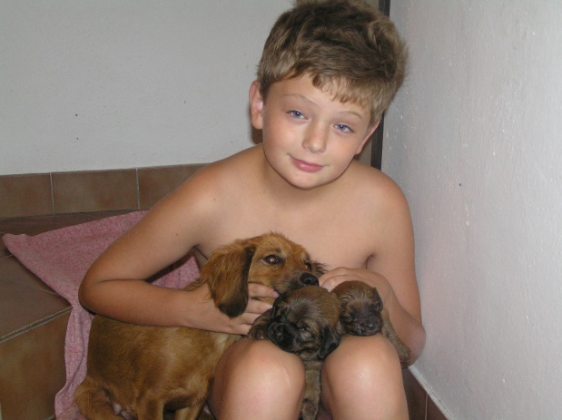
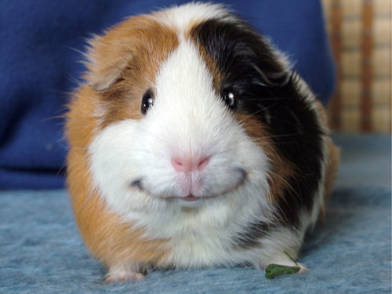
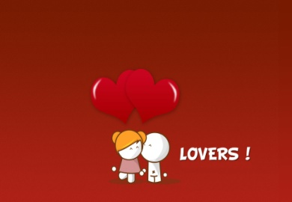
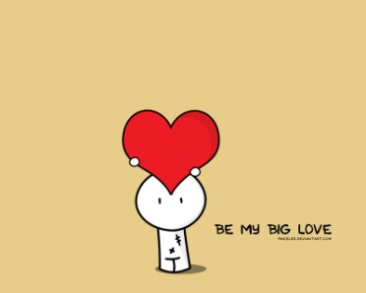
What I like…
My dancing group Krúžek
My brother with my pets (dogs)
My another pet guinea-pig
And my kind parents and my boyfriend and friends... ☺
I love them!!

Slide 4
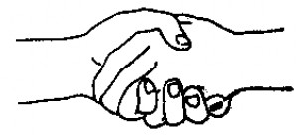
I hope to meet you all soon ☺

